Slide 1

CSCI 466: Networks
Lecture 1: Introduction, Syllabus, and Logistics
Reese Pearsall
Fall 2023
https://www.cs.montana.edu/pearsall/classes/fall2023/466/main.html

Slide 2


Communication in the Digital Era

Slide 3

Communication in the Digital Era

Slide 4


Communication in the Digital Era
“Hello, John!”

Slide 5


Communication in the Digital Era

Slide 6

Communication in the Digital Era

Slide 7


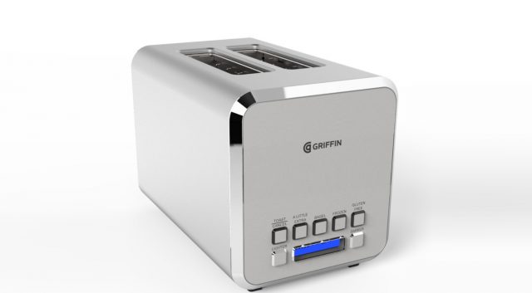


Communication in the Digital Era

Slide 8


Communication in the Digital Era

Slide 9







Communication in the Digital Era

Slide 10
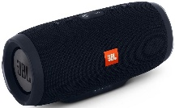


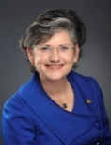




Communication in the Digital Era

Slide 11

Communication in the Digital Era

Slide 12
Communication in the Digital Era

Slide 13
Communication in the Digital Era

Slide 14

Communication in the Digital Era

Slide 15
Communication in the Digital Era
We have billions of devices that are constantly communicating with one another
306.4 billion emails are sent every day
There were 4.66 billion active internet users around the world in January 2021
Facebook generated four petabytes of data every day in 2020.
https://techjury.net/blog/how-much-data-is-created-every-day/#gref

Slide 16
Communication in the Digital Era

Slide 17
Communication in the Digital Era
???

Slide 18

Communication in the Digital Era
The Internet

Slide 19
Communication in the Digital Era
How does computer A send a message to computer B?
The Internet

Slide 20
Communication in the Digital Era
How does computer A send a message to computer B?
The Internet
There are layers or steps that describe the process for communicating over a computer network

Slide 21
Communication in the Digital Era
What are the different ways to design a computer network?
The Internet

Slide 22
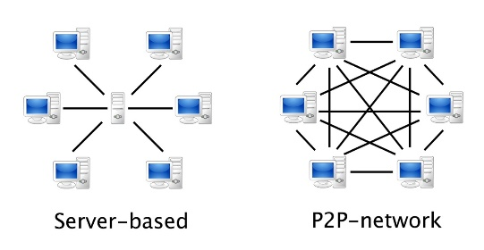

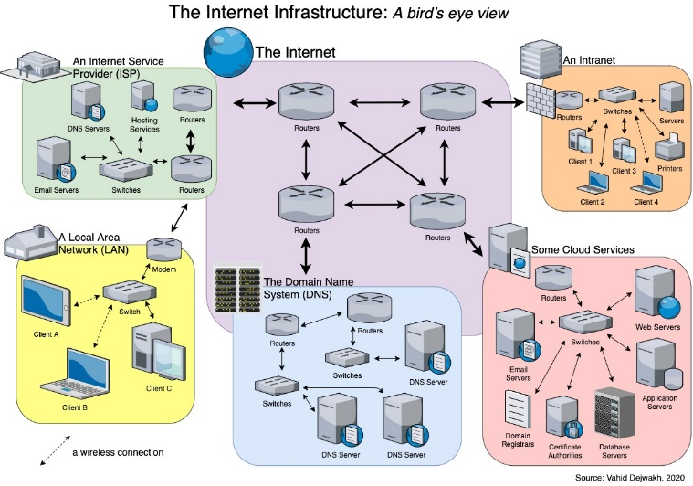
Communication in the Digital Era
What are the different ways to design a computer network?
The Internet

Slide 23
Communication in the Digital Era
What are the rules and protocols for communicating over a network?
The Internet

Slide 24
Communication in the Digital Era
What are the rules and protocols for communicating over a network?
The Internet
HTTP
UDP
TCP
SMTP
DNS
SSH
FTP

Slide 25
Communication in the Digital Era
How can we measure the performance or efficiency of a network?
The Internet

Slide 26
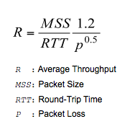
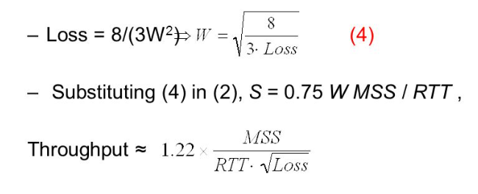
Communication in the Digital Era
How can we measure the performance or efficiency of a network?
The Internet

Slide 27



Communication in the Digital Era
How can we make our communications safe and trustworthy?
The Internet

Slide 28

CSCI 466- Course Outcomes
List the network layers and explain their function in end-to-end communications
Explain different network architectures and tradeoffs in the design decisions
Explain the functions of various Network protocols (HTTP, DNS, TCP/IP, FTP, etc)
Design and implement network application
Analyze network traffic
Measure network performance
Explore security issues in networks and understand important defense mechanisms

Slide 29

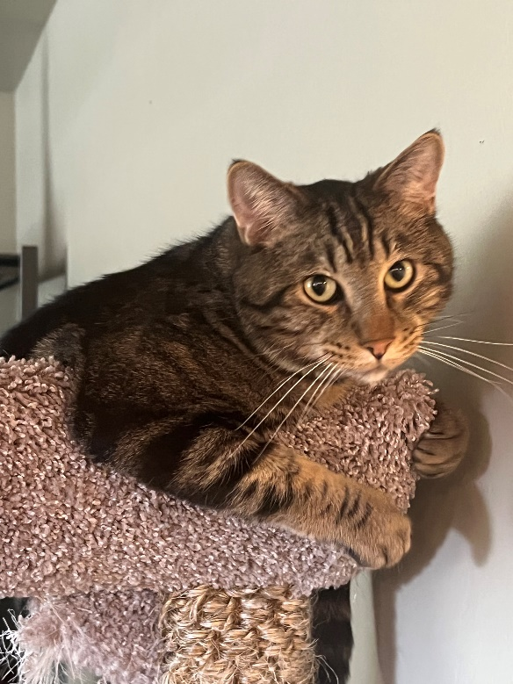





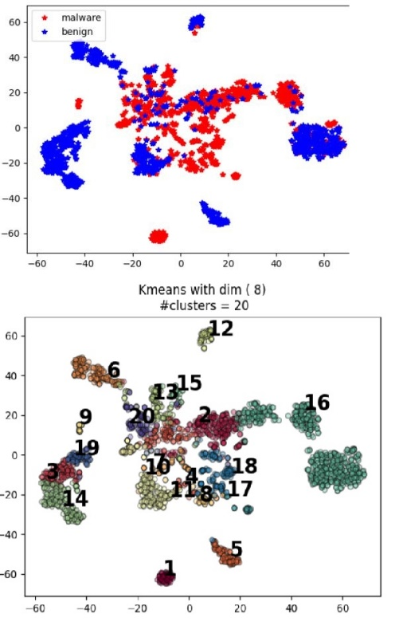
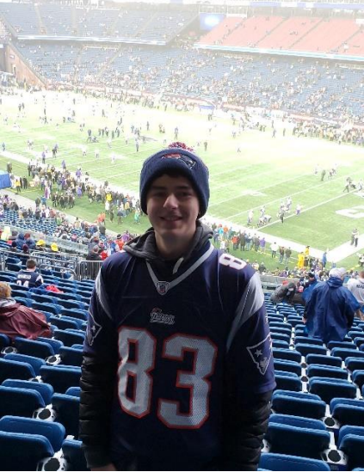
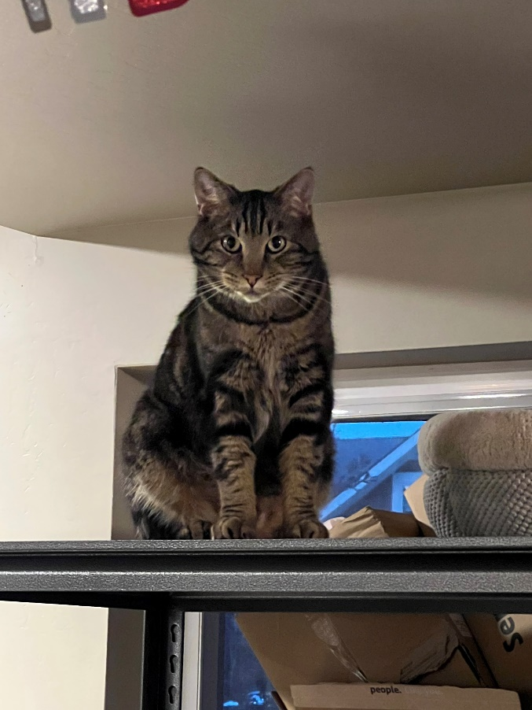
Reese Pearsall
(pierce-all)
Second year Instructor @MSU
B.S & M.S @ MSU
Hometown
Billings, MT
Interests
Cybersecurity
Malware analysis and detection
Cybercrime
Computer Science Education
Teaching
CSCI 132
CSCI 466
CSCI 476
Experience
Software Engineer and Tester, Techlink (Bozeman)
Software Engineer, United States Air Force (Hill AFB, Utah)
Cybersecurity Software Engineer, Hoplite Industries (Bozeman)
Graduate Researcher, MSU (Bozeman)
Outside of academia
Video games, New England Patriots, Fantasy Football, TikTok, Movies, Memes, The Bachelor, Naps

Slide 30
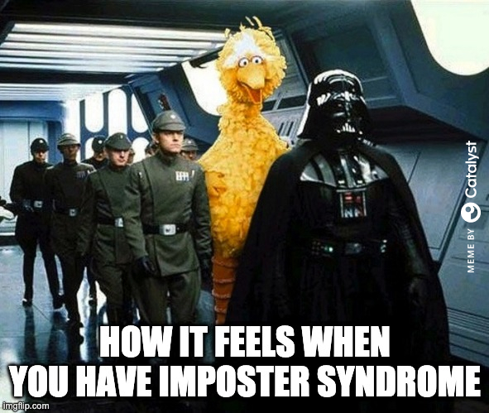
My Experience
I do not consider myself to be a computer networking expert
I do not have any formal publications in the field of computer networks
I am very comfortable with the content of this course
I will always try to answer your questions, even if its not right away

Slide 31

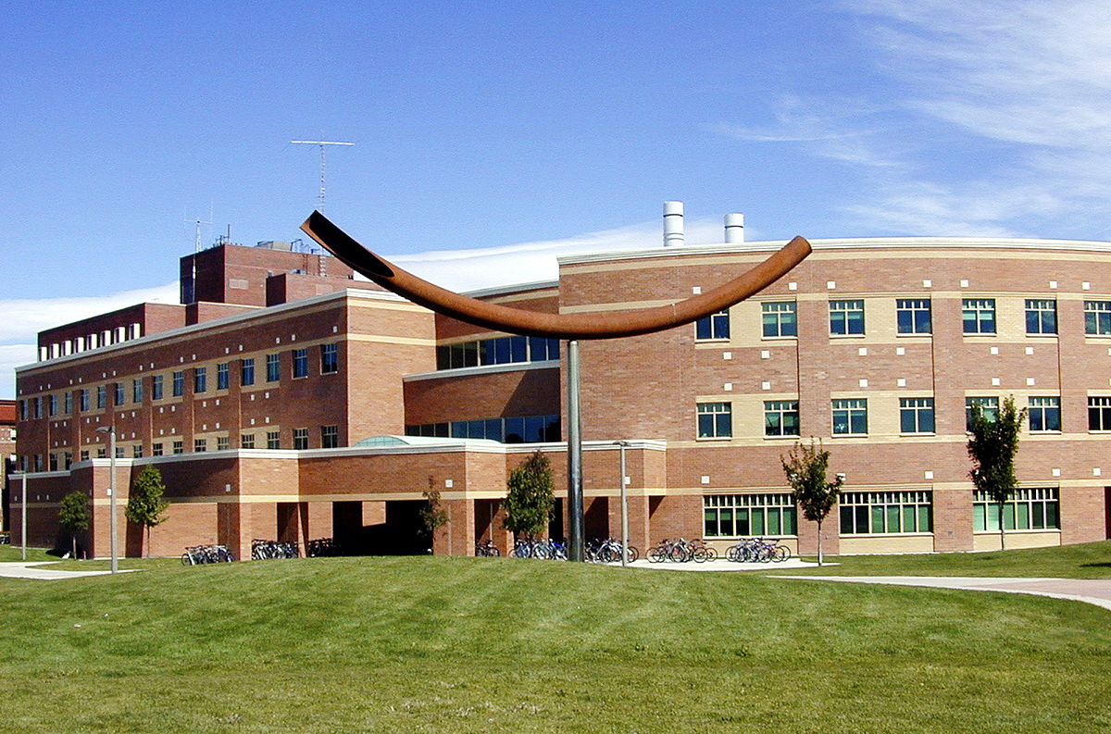


Contact
Email: reese.pearsall@montana.edu (I will respond as soon as I can)
Office Hours: Monday Wednesday Friday 1:00 – 2:00 PM
Thursdays 1:30 – 2:30 PM
Office: Barnard Hall 361
(my office will generally still be open after 2:00)
I am also very responsive on Discord!
(@reese_p)

Slide 32
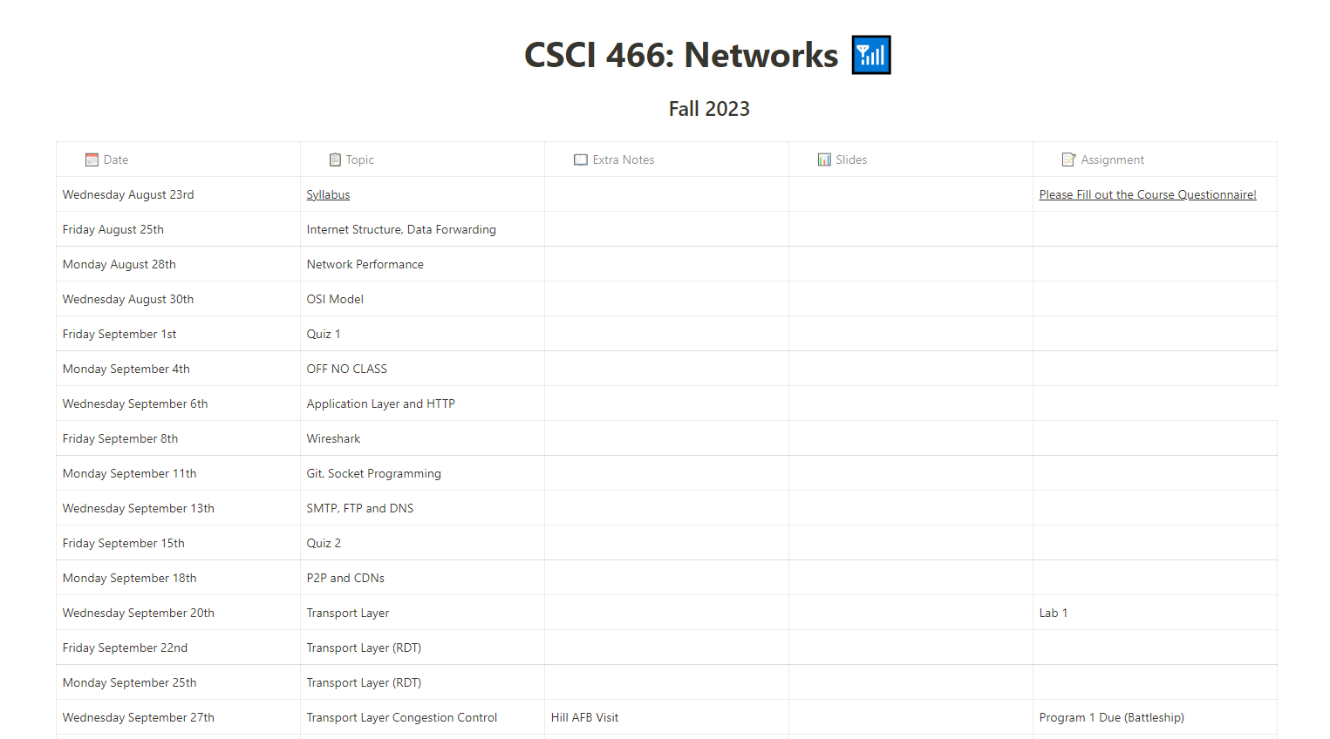


Logistics
Class Meetings
MWF: 12:00 – 12:50 PM
Reid Hall 202
Course Website: https://www.cs.montana.edu/pearsall/classes/fall2023/466/main.html
We will be using Discord for class communication and for announcements

Slide 33
Prerequisites
• CSCI 232- Data Structures and Algorithms
• CSCI 112- Programming with C
• CSCI 366- Computer Systems (recommended)
Before taking this class, I expect you to be comfortable with:
• Python
• Writing and debugging programs of moderate complexity
• Git & Github (we will likely review this)

Slide 34

Schedule

Slide 35
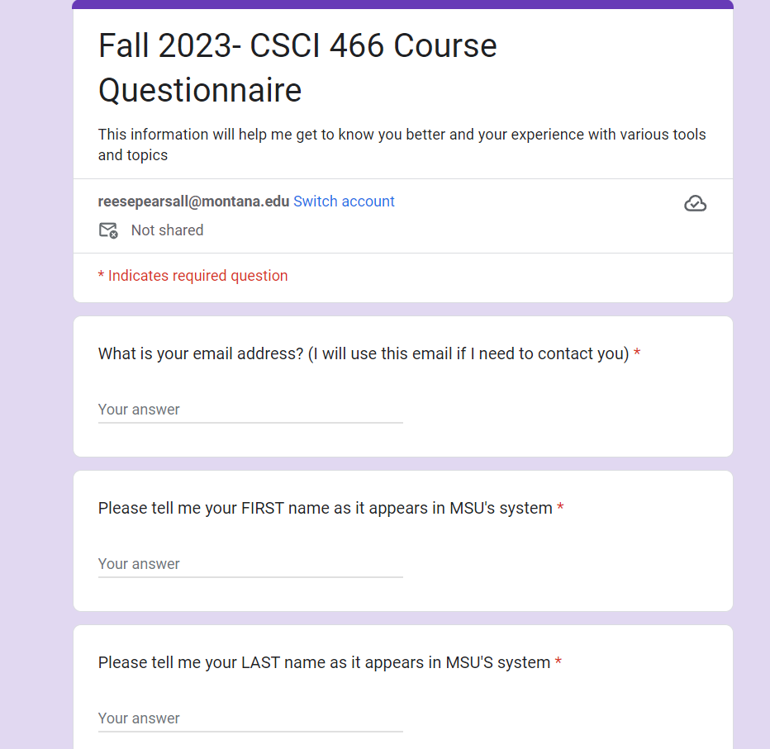

Course Questionnaire
Please take some time to do the course questionnaire today or tomorrow
Your answers are important to me, and will help make this class a better experience

Slide 36
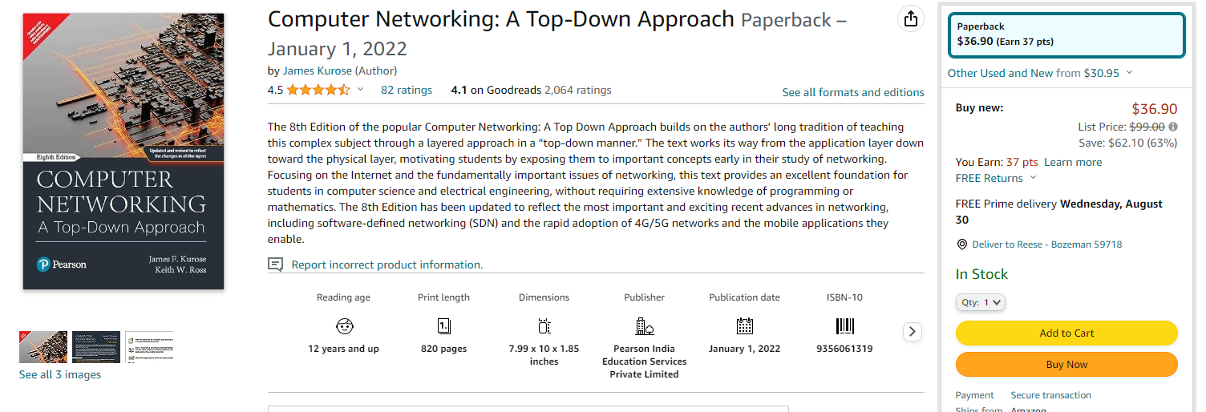
Textbook
(optional)
I will not require you to get the textbook, but it is a great resource for learning the material and doing the assignments
(currently not in the bookstore)

Slide 37
Grading
40% Programming Assignments (5)
30% Wireshark Labs (6?)
20% Quizzes (8)
10% Final Quiz

Slide 38
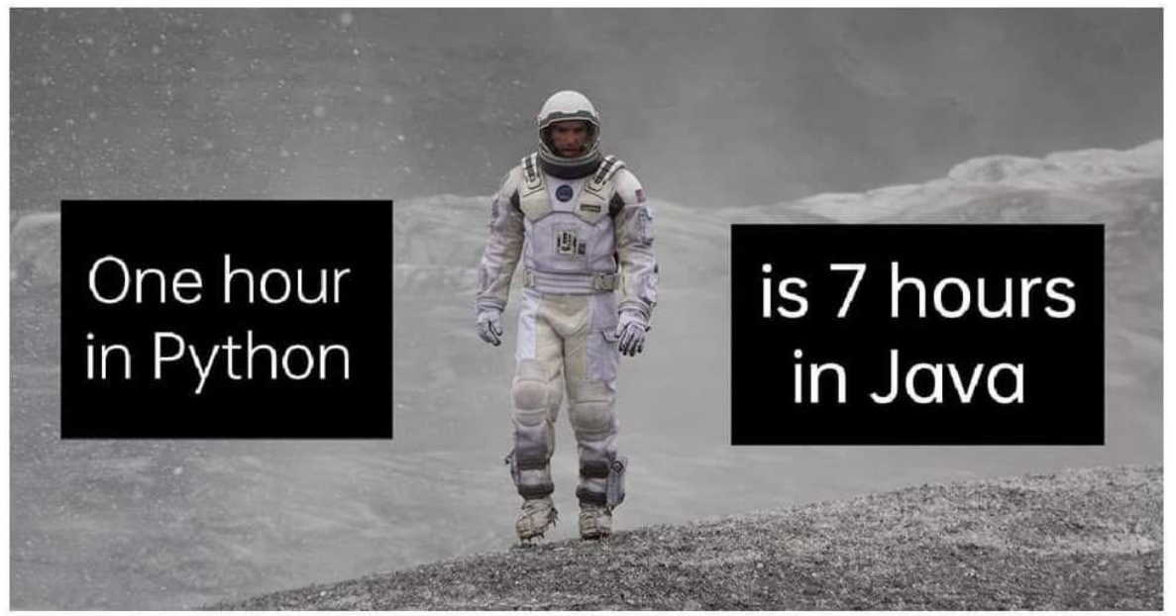
Grading Breakdown
40% Programming Assignments (5)
Create network applications using a language of your choice
Requires a good chunk of your time
You will place your assignments in a private GitHub repository and submit the repo link to D2L
You will record a short video demo showcasing the functionality of your program
You are allowed to work with one partner (encouraged)

Slide 39

Grading Breakdown
30% Wireshark Labs (6)
Analyze real network traffic and see network concepts and protocols in action
Follow instructions using Wireshark and document your findings and observations in a word document
Submit report to D2L as a PDF
You are allowed to work with one partner (encouraged)

Slide 40
Grading Breakdown
20% Quizzes (7)
Every other week, there will be a quiz on Friday
No lectures on quiz days
Tests your knowledge on basic networks concepts we talk about in lecture
Administered via D2L (auto-graded)
Quizzes will be open for a 3-5 hour window, not timed.
I’ll drop your lowest quiz grade

Slide 41
Grading Breakdown
10% Final Quiz
Only two questions
Cumulative quiz that evaluates your knowledge of the entire semester
Question 1: You will be asked to document and label the layers and aspects of the OSI model
Question 2: Secret
Note sheet not allowed
Will take place during finals week or the week before (TBD)

Slide 42
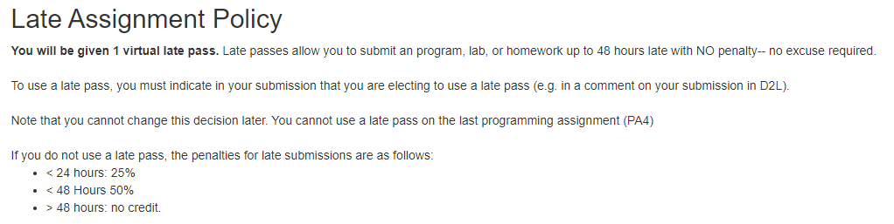
Late Assignment Policy

Slide 43
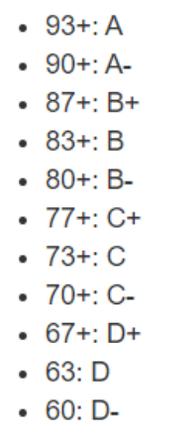

Grading Scale
At the end of the semester, if you are within 1% of the next letter grade, I will bump you up
I will not curve assignment or exam grades

Slide 44
Plagiarism, Academic Misconduct, Generative AI tools
Plagiarism and cheating is very not cool
You are not allowed to submit something that is not your own, and you are not allowed to steal solutions from another person and modify it
I have a Chegg and Course Hero membership. Don’t try it
Using small snippets of code from the internet is acceptable (but should not be needed). If you do use a small snippet of code from the internet, you should leave a reference as a comment in your code
Do not use any tools or AI that will write code or solutions for you

Slide 45

MSU Resources
https://www.cs.montana.edu/pearsall/classes/msu_resources.html

Slide 46
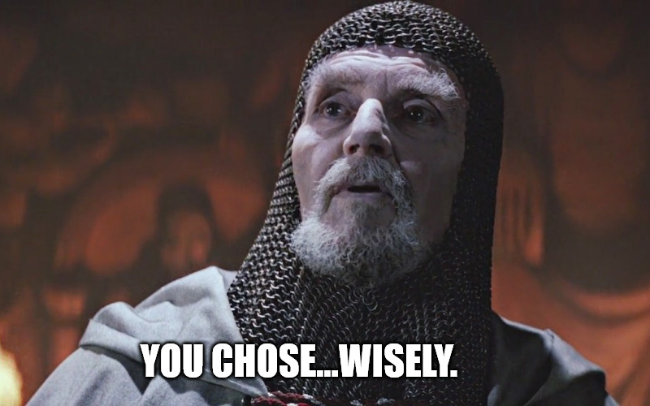
How to do well in this class
Don’t wait until the last night to do an assignment
Get help when you need it
Come to class and office hours
Have fun

Slide 47
Questions?

